Slide 1
Advancements in Forecasting
Strategy for choosing right forecasting techniques
Prasanth Nandanuru ,
Distinguished Engineer ,Wellsfargo

Slide 2
Disclaimer
Views and opinions expressed in my presentation are solely my own and do not necessarily reflect the views or opinions of my employer.While my presentation may touch on some of the work that I do at my company, it is important to note that the contents of my speech are based on my own research, thoughts, and ideas. Any statements or recommendations made during my talk are not endorsed by my employer and should not be taken as official company positions or policies.

Slide 3
Agenda
Case Study : Problem Definition
Forecasting Models:Challenges
Synthetic data generation : Text and Images
Privacy
Summary

Slide 4
TimeSeries
TimeSeries forecasting targets to forecast future observations of target series based on historical information of the past .
Example:
No of customers visiting Store
Predict next payment of customer
Crypto price
Number of tickets in production

Slide 5
Problem Statement : Cash Recycling and Forecasting
Stores
Key Business Drivers:
Optimal cash management -Short vs Excess
Reduce expenses -Transportation and storage costs
Cash Forecasting -Proactive vs Reactive
Customer Experience
Transportation
Fulfillment Centers

Slide 6
Cash Positions - Explanatory vs Observation variables
Explanatory Variables
DateTimeStamp | StoreID(AU) | Line # | GeoLocation (hash) | StoreType | Start_Cash(USD) | End_Cash(USD)
2023-09-09 09:06:53 | 1234 | 11 | 2pxqmv1 | Prime | 20,010 | 80,000
2023-09-09 09:08:53 | 4567 | 42 | 9xxqmv2 | Prime | 10,000 | 4000
2023-09-09 09:08:54 | 1234 | 17 | 2pxqmv1 | Prime | 8000 | 9000
2023-09-09 09:08:53 | 8960 | 8 | 4yxqmv4 | Non Prime | 4000 | 9000
…
Observation Variables

Slide 7
TimeSeries Data: Forecasting Methods and Challenges
UniVariate :Time vs Target variable
MultiVariate :Time + Multiple features vs Target variable
ARMA(Stationary)/ARIMA(Non Stationary)/SARIMA (Seasonality)
ARCH/GARCH -Volatility
Prophet - takes care of missing values
ARMAX (P)/LSTM (non parametric)
DART(NBEATS/NHITS)

Slide 8
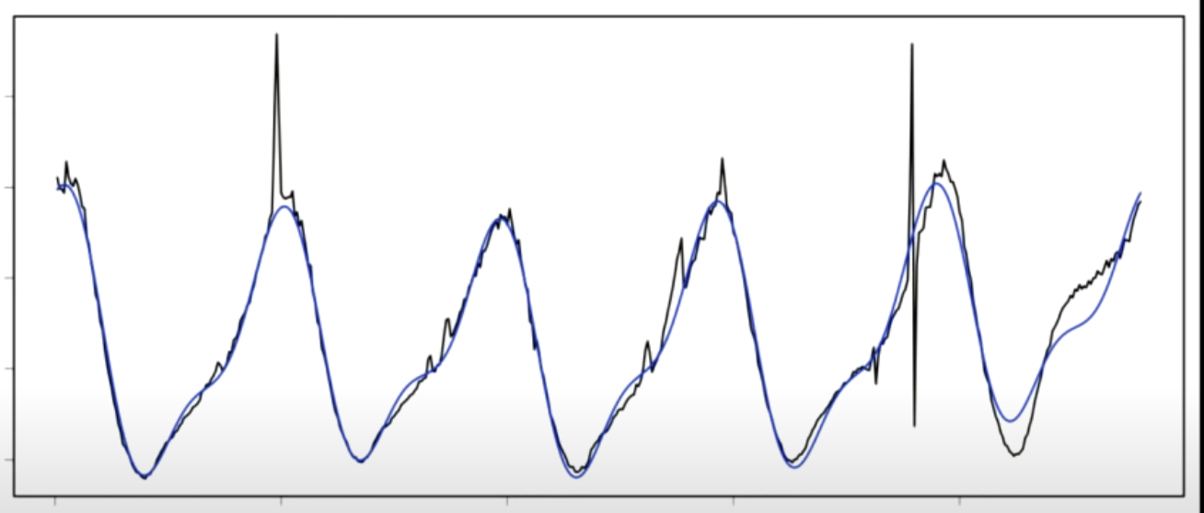
TimeSeries Data: FFT
Remove noise on input data (high frequency and low amplitude)
Decompose into multiple sinoid component
Apply FFT one each sin wave and combine
Value
Time

Slide 9
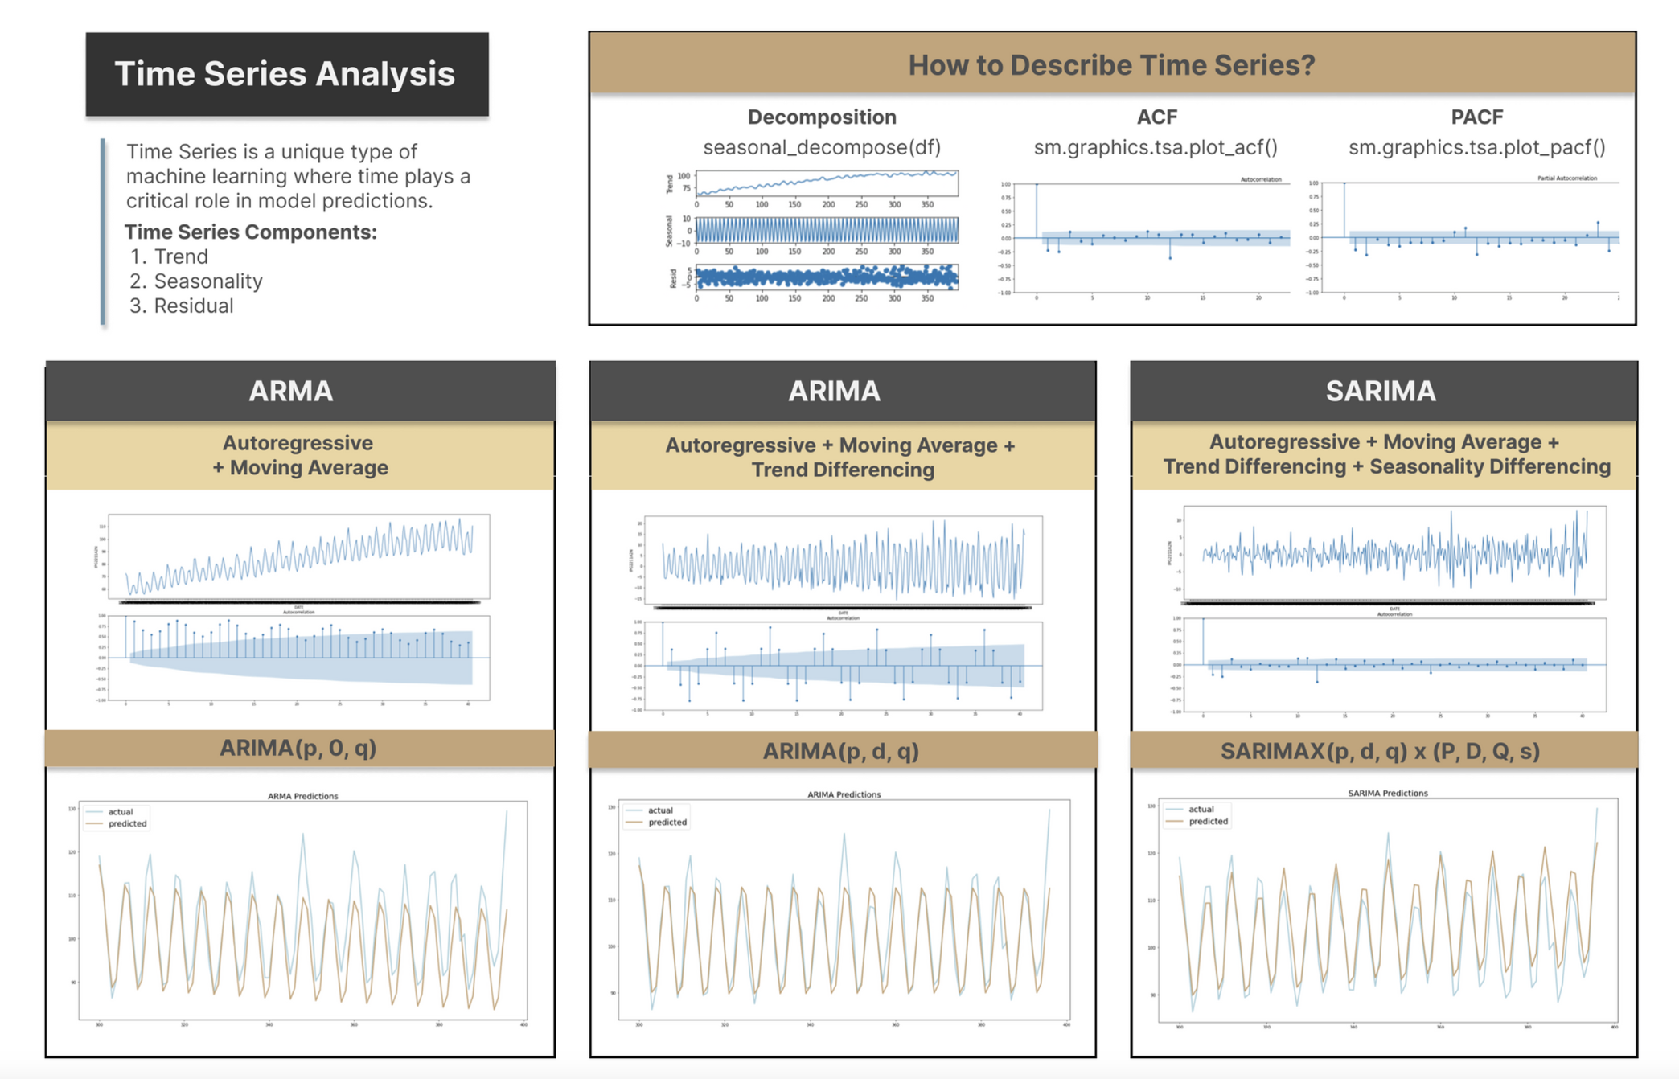
Time Series - Traditional Analysis -EDA and Statistics

Slide 10
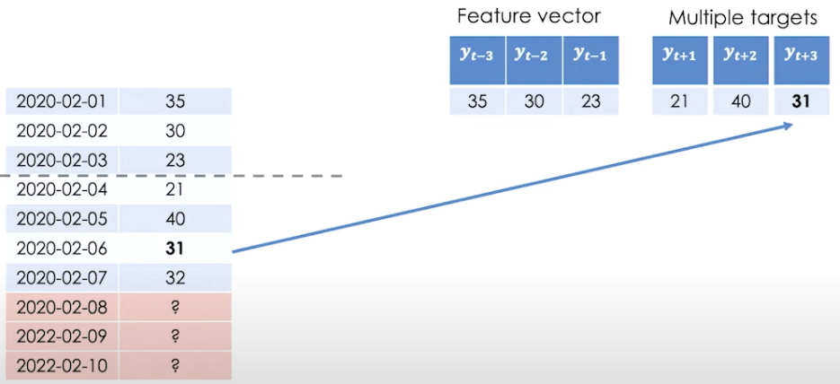
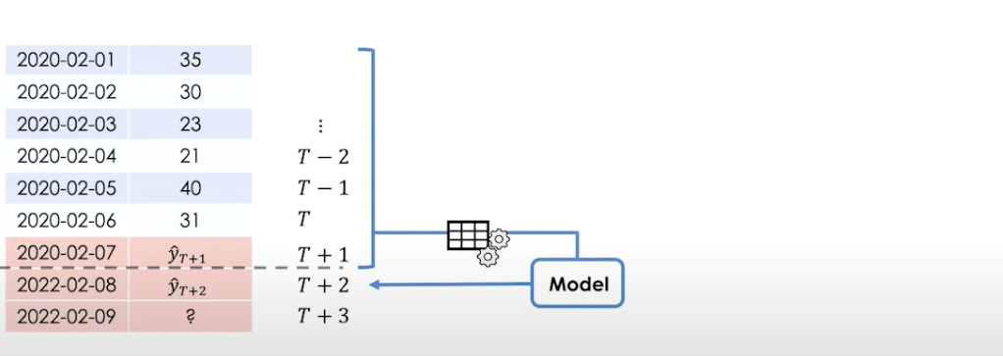
Time Series - ML Forecasting techniques
Date
Position
(USD in K)
Same Features with multiple models
Each model predicts different target variable
High maintenance and inefficient
Different features
Same Model predicts target variable recursively
Efficient and low maintenance

Slide 11
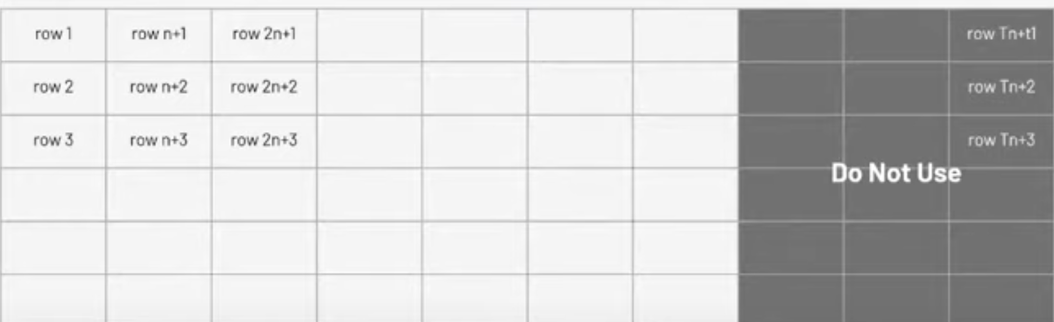
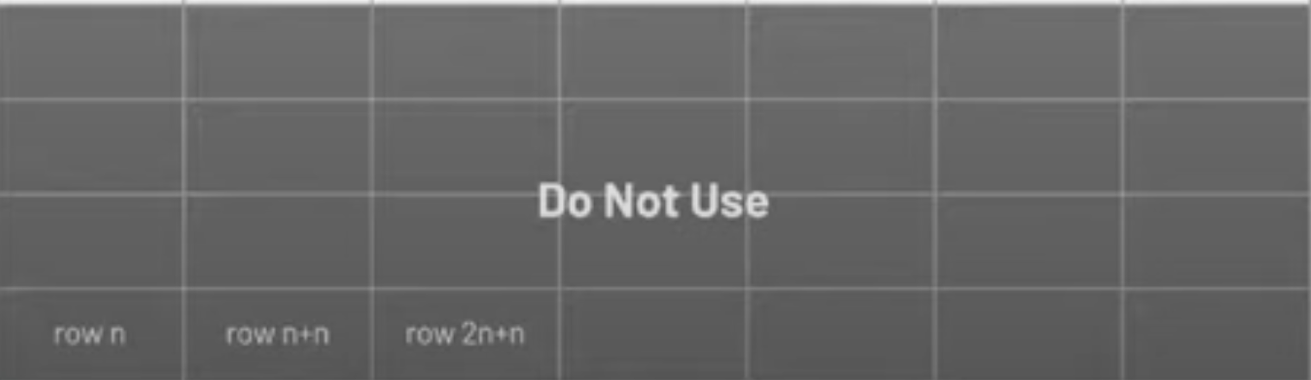
Time Series - Cross Validation
T0
T1
T2
Tt
STORE 1
STORE 2
STORE 3
Cross Validation Data
STORE n

Slide 12
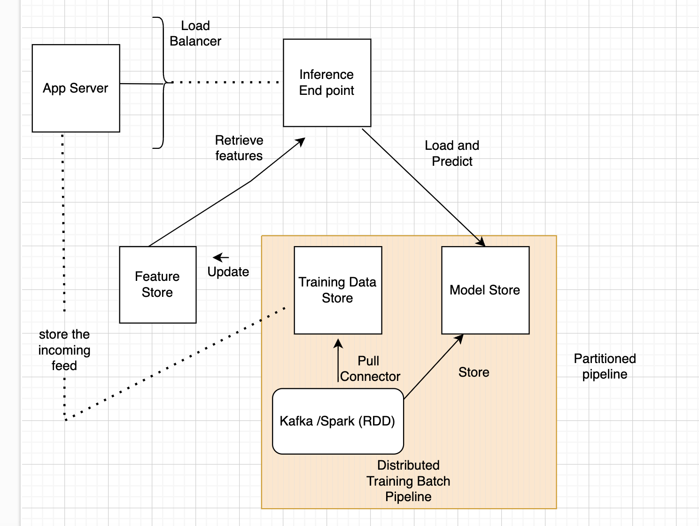
Distributed Training and Serving

Slide 13
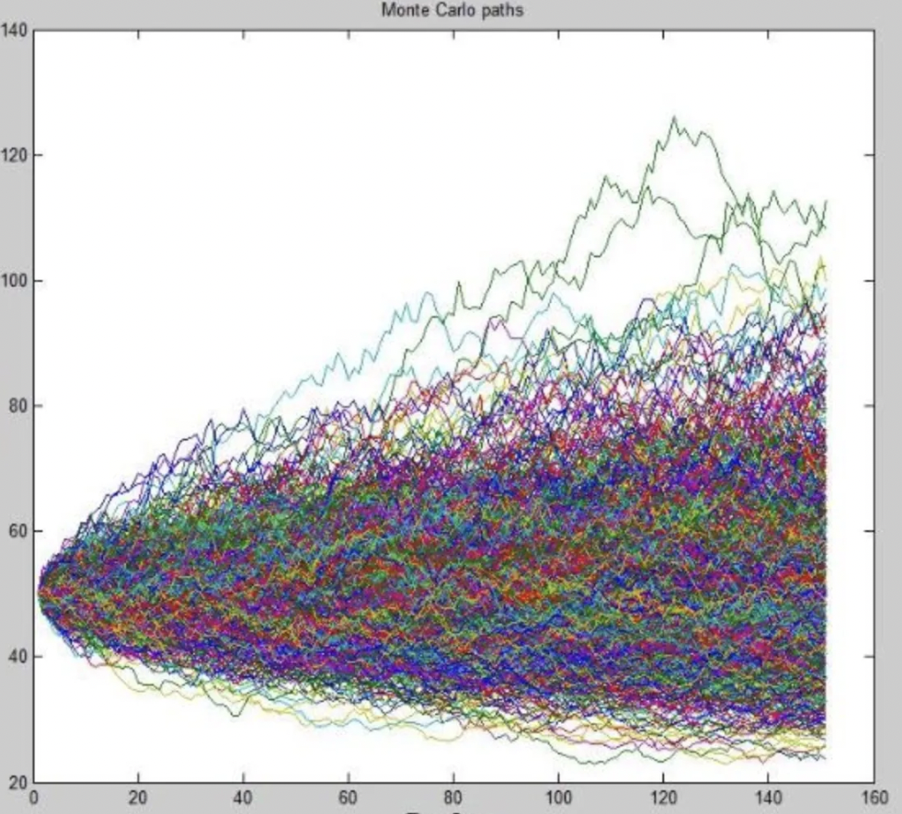
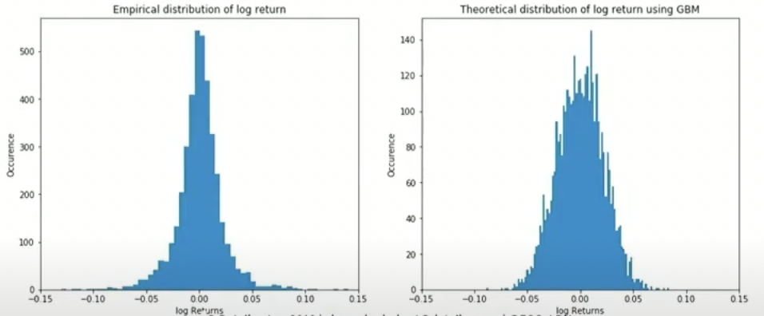
Time Series - Fat Tails Problem
Cash Forecast
TimeSteps

Slide 14
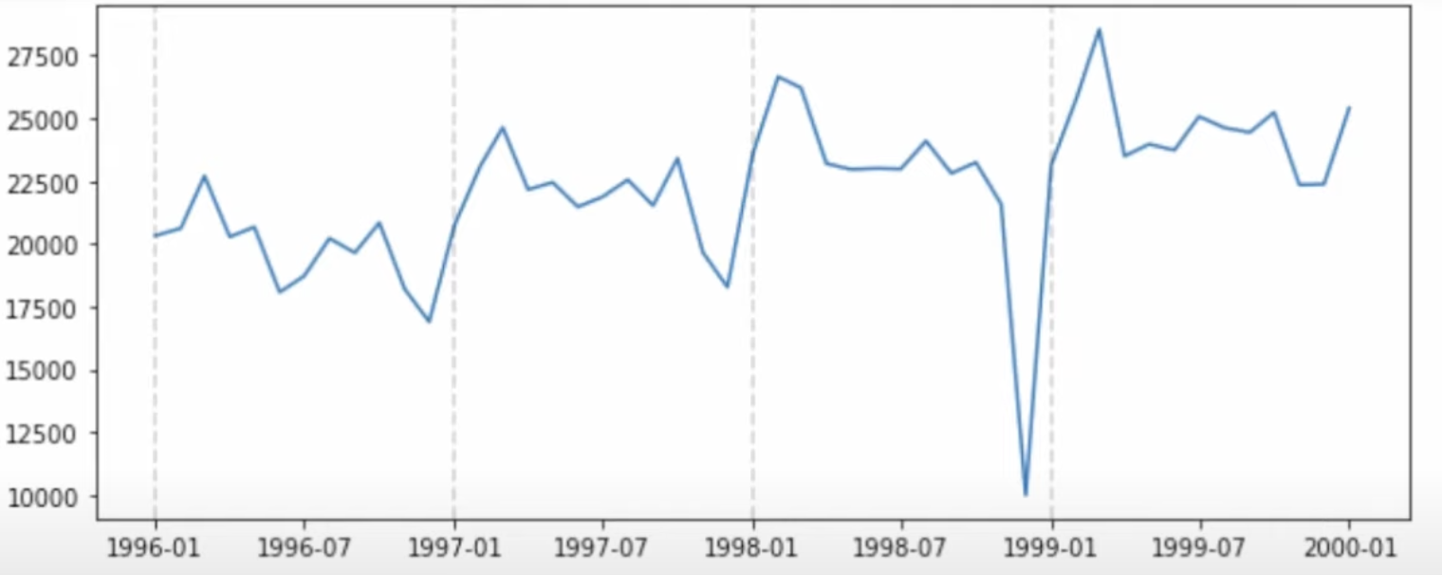
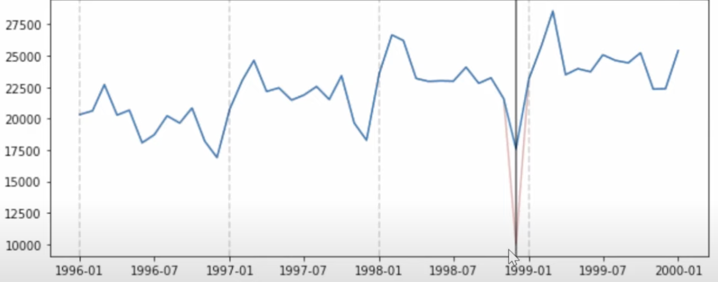
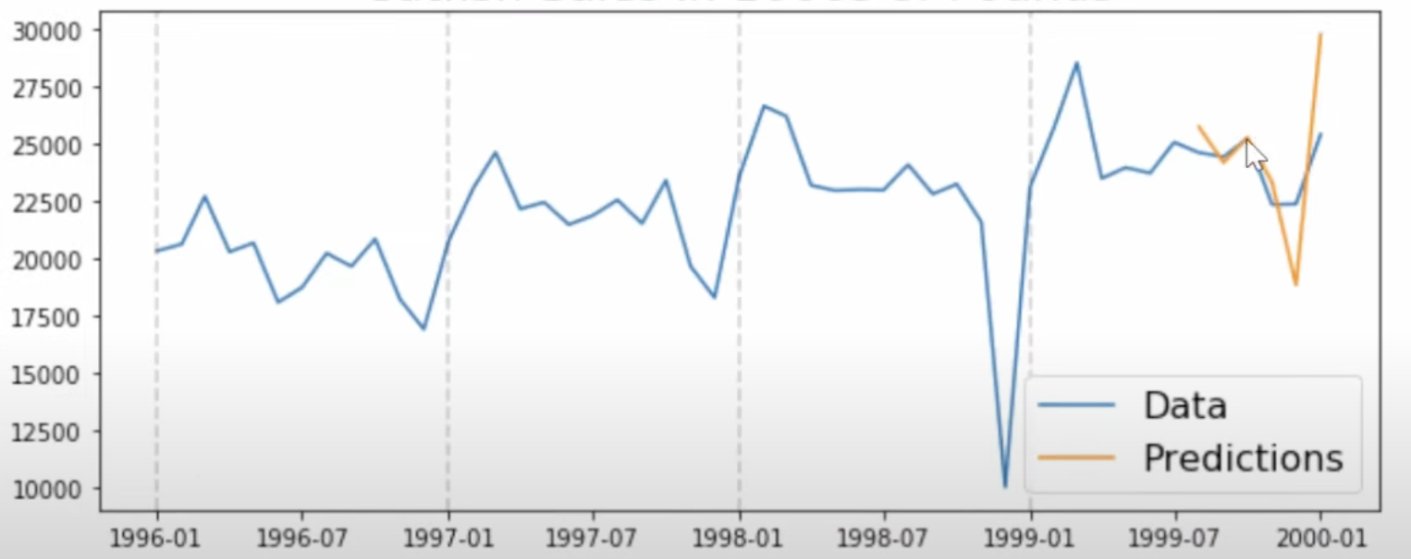
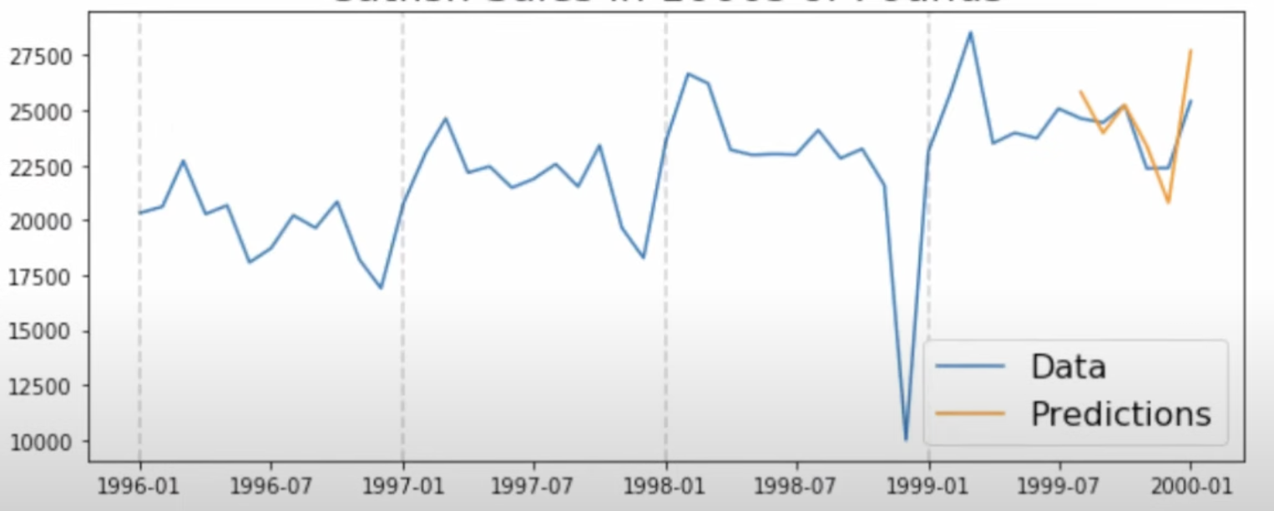
Anomaly Detection -Traditional approach
Anomaly in TimeSeries
Correct the Series using : Standard Deviation using Seasonal Method
C
a
s
h
P
o
s
i
t
i
o
n
s
C
a
s
h
P
o
s
i
t
i
o
n
s
Prediction on Anomaly Timeseries
Prediction on Corrected TimeSeries
Date Window
Date Window

Slide 15
Need for Synthetic Data
Privacy and Confidentiality :PII and Regulations-GDPR/CCPA/PCI
Simulations : Planning and A/B Testing
Anomalies in real data
Data corruption
Research and Collaboration : Academia and joint collaborations

Slide 16
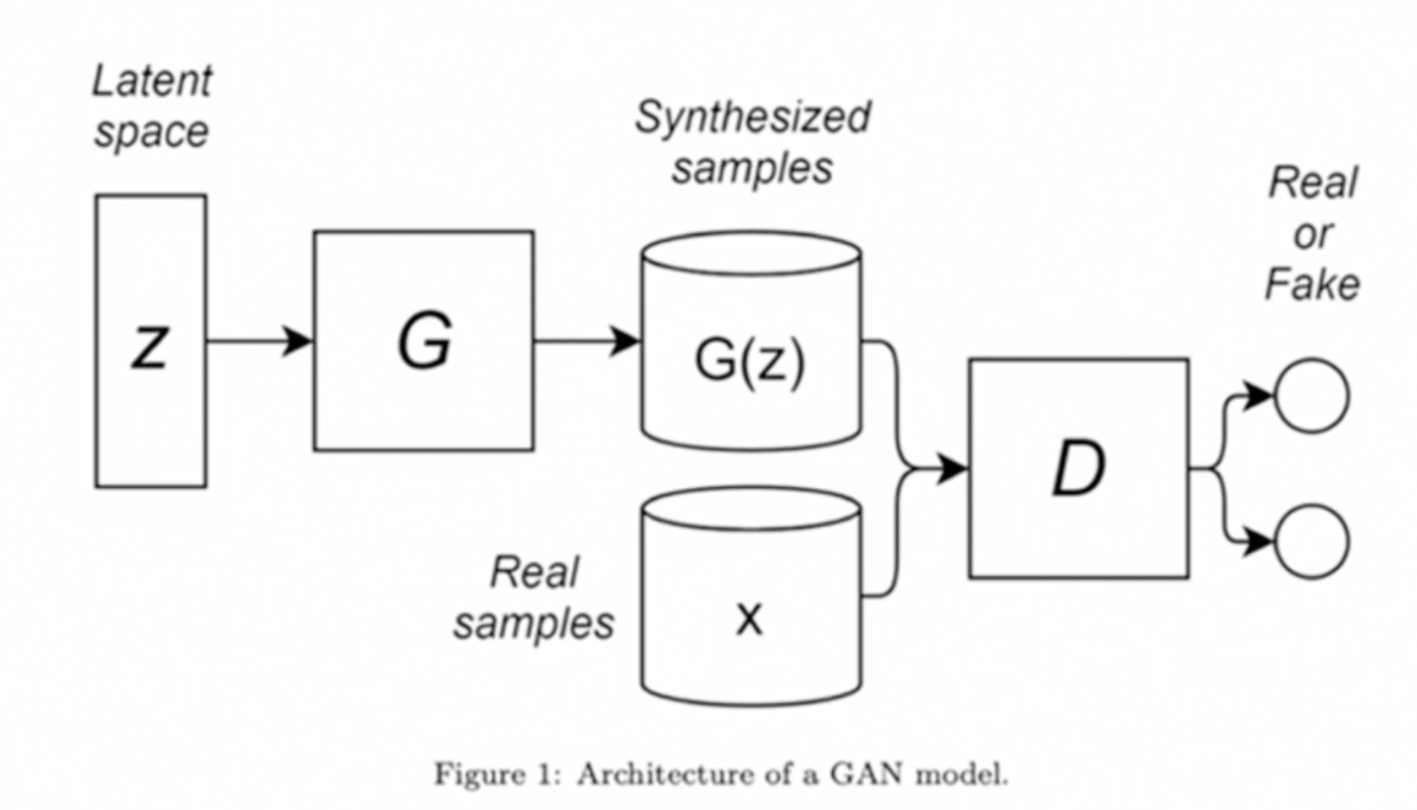
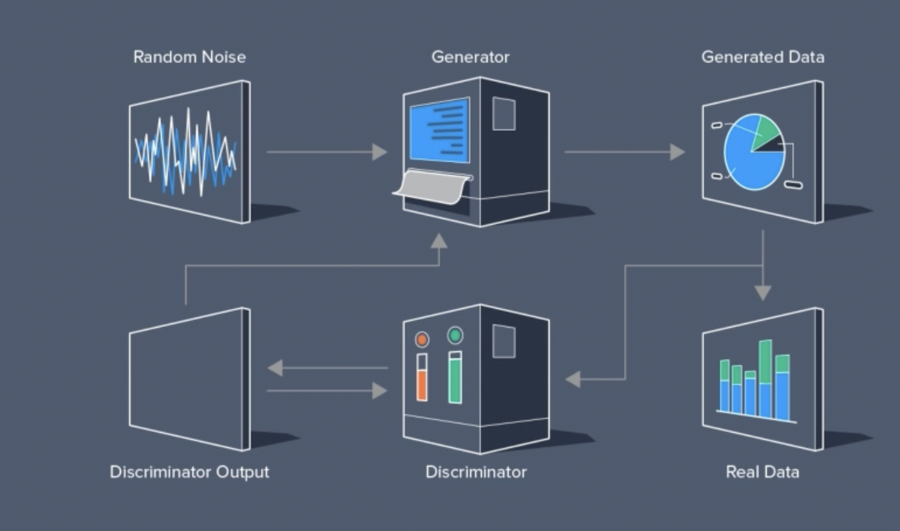
GAN -Generative Adversarial Network
Two networks -Generator and Discriminator
Generator (G) model tricks the Discriminator (D) model
to think generated model is real
If Discriminator(D) chooses a fake image as real ,
the Discriminator will adjust its model weights
If Generator(G) creates a fake image as real ,
the Generator will adjust its model weights

Slide 17
WGAN -Wasserstein GAN
Challenges with classic GAN:
Mode Collapse (stuck in peak of distribution)
Loss value vs Quality of image
Flat Gradient - Distance between distributions is very large or very small
ARMA -Stationary
WGAN :
Critic : No restrictions on value of critic (0 to 1)
No more flat gradients

Slide 18
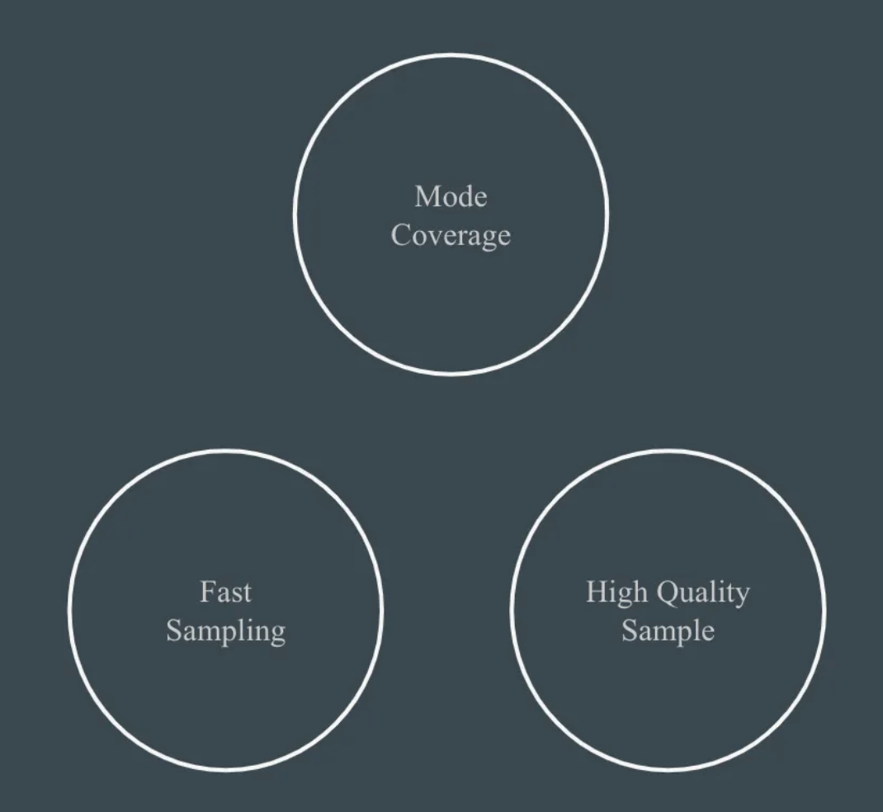
Generative Model Trilemma

Slide 19
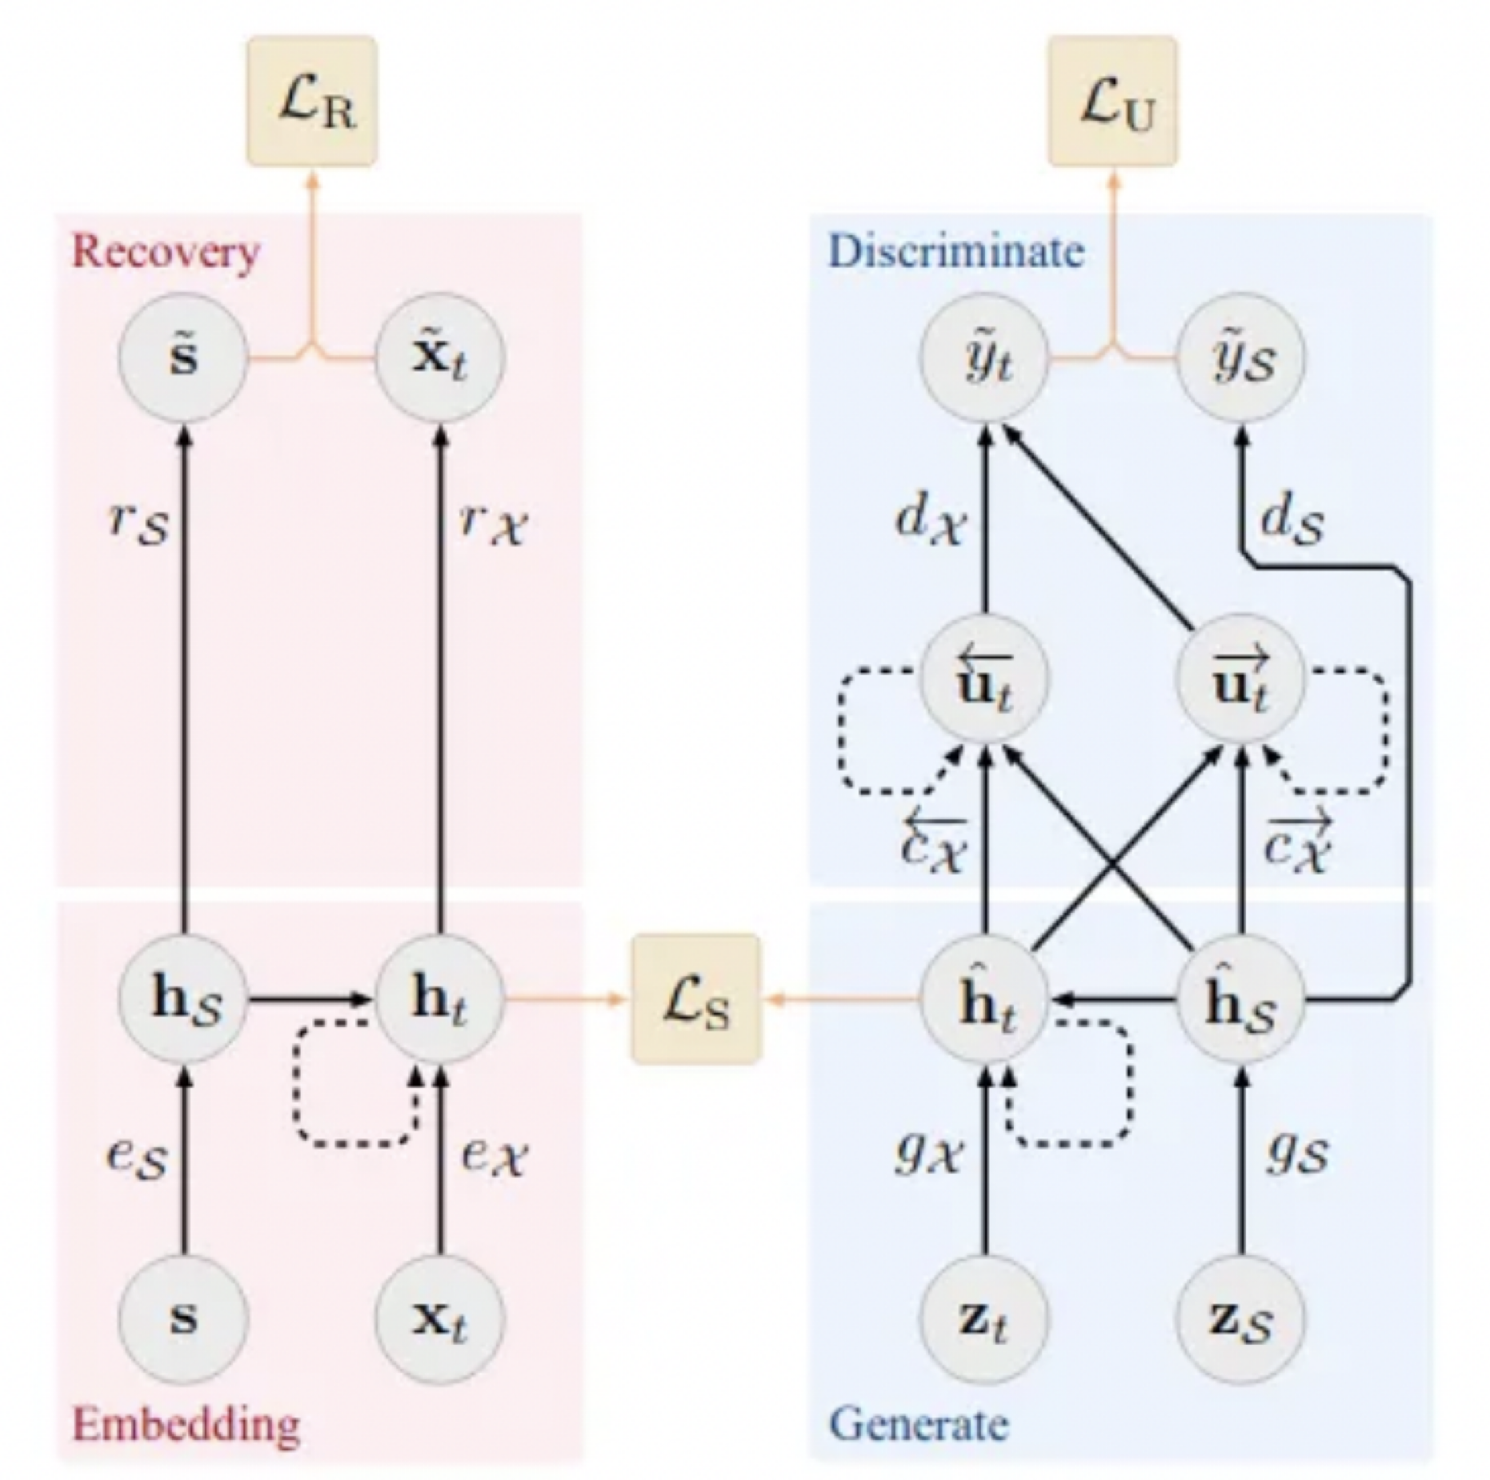
TimeGAN
Apart from Generator ,Discriminative models , there are Embedding and
Recovery models
3 loss functions - Reconstruction , Supervised and Unsupervised
Training: AutoEncoder for optimal reconstruction
Training Supervisor to capture temporal behavior
Training 4 models while minimizing the 3 loss functions
Less sensitive to hyper parameters changes and more stable
training process

Slide 20
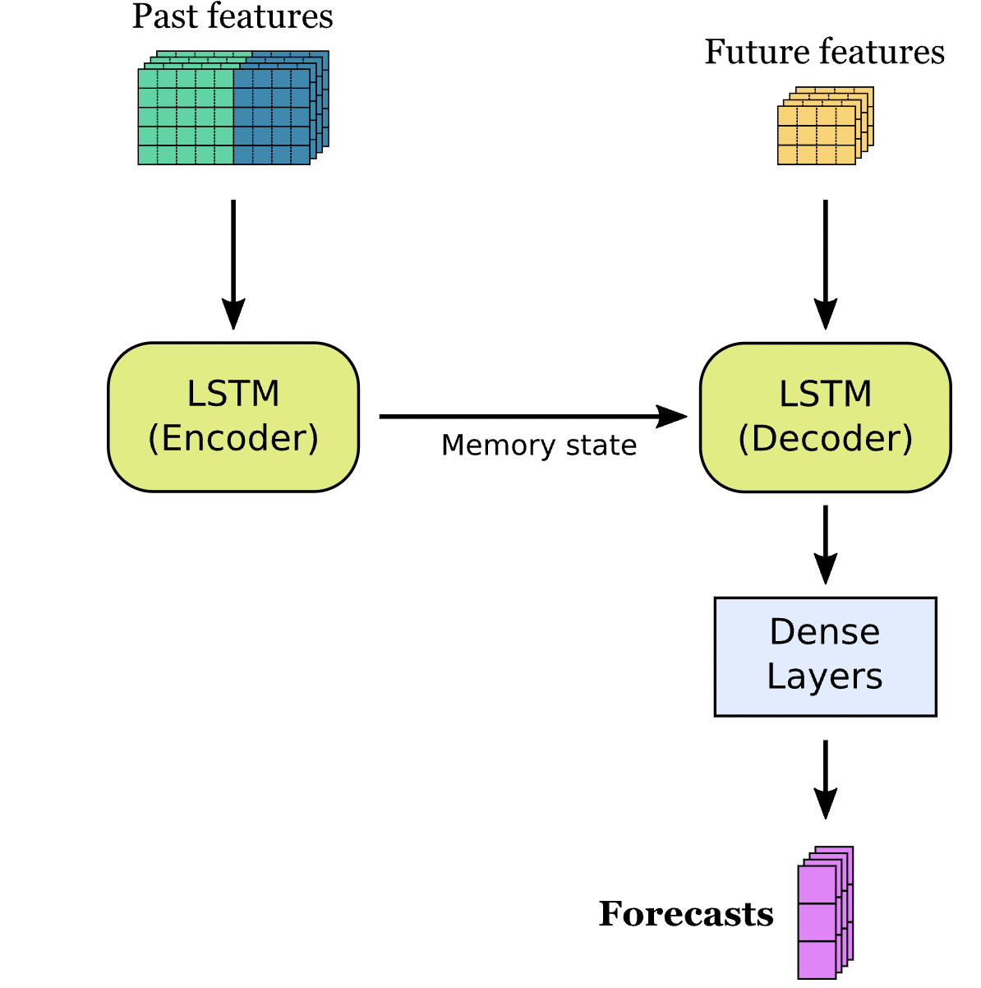
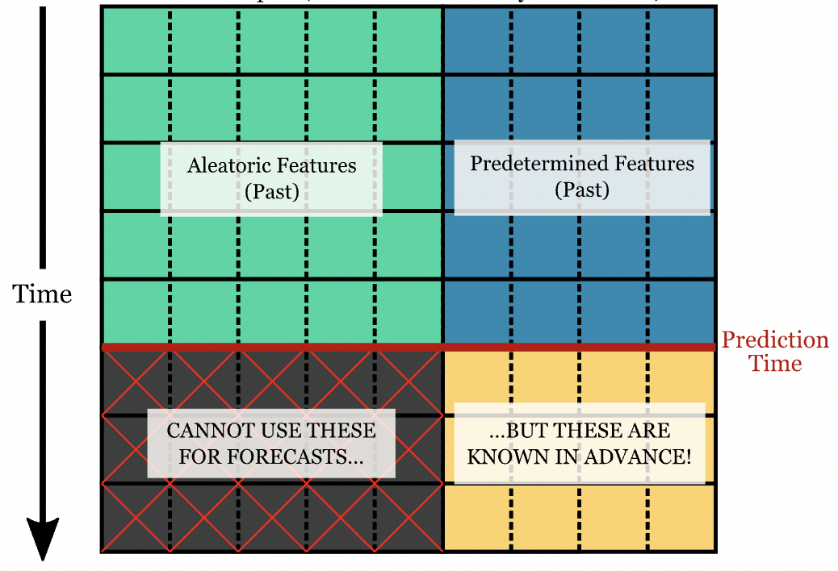
LSTM -Long Short Term Memory Models
#Deposits ,#Withdrawals #outages
Month ,Season ,day of week

Slide 21
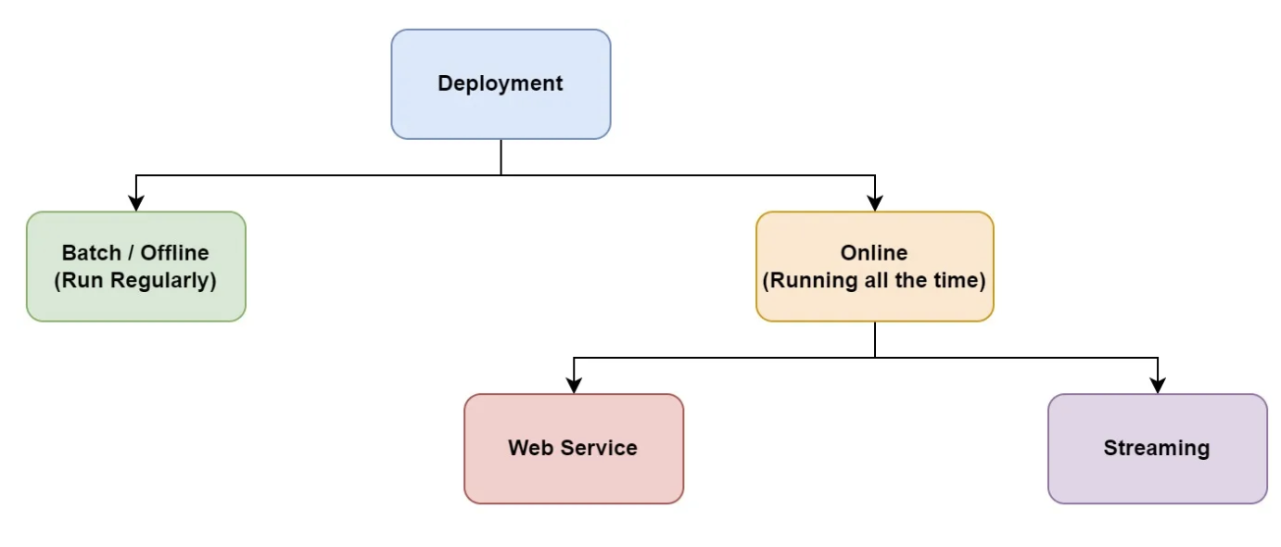
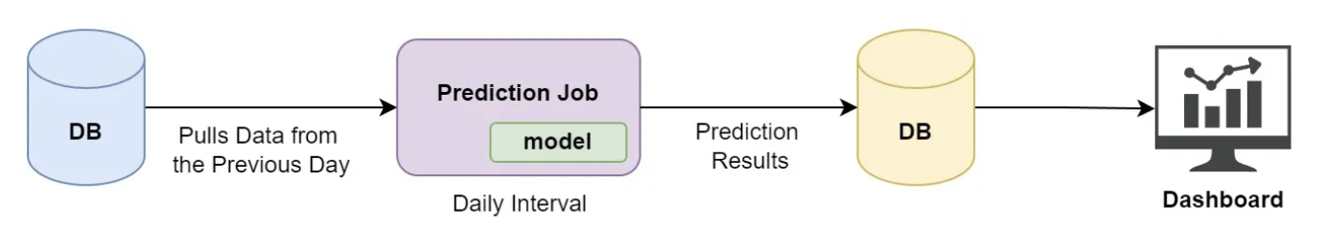
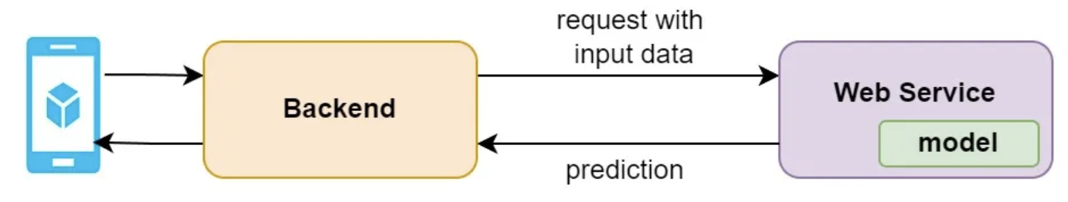
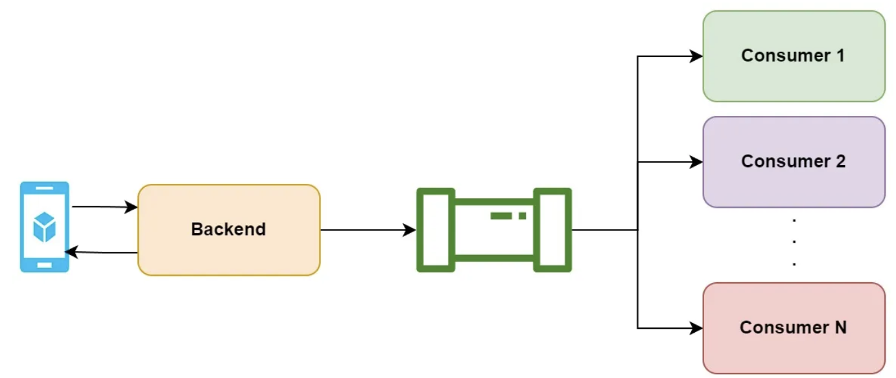
Deployment approaches
Batch
Real time
Near Real time (Streaming)

Slide 22
Summary
Time Series Problems require domain knowledge
Selection of models is dependent on business goals Training time vs Performance vs Time to Market
Synthetic data generation is not just for Testing . Use for Remix and Simulation of business models
Text and Image Generation using Generative AI solutions are gaining lot of traction and competitive advantage versus Discriminative AI
Privacy , XAI are not good to have but must to account for for any AI solution.

Slide 23
References
https://papers.nips.cc/paper/2019/file/c9efe5f26cd17ba6216bbe2a7d26d490-Paper.pdf
https://github.com/openai/CLIP
https://openai.com/research/clip
https://github.com/microsoft/semantic-kernel
https://docs.langchain.com/docs/use-cases/apis
https://github.com/NVIDIA/NeMo-Guardrails

Slide 24
THANK YOU

Slide 25
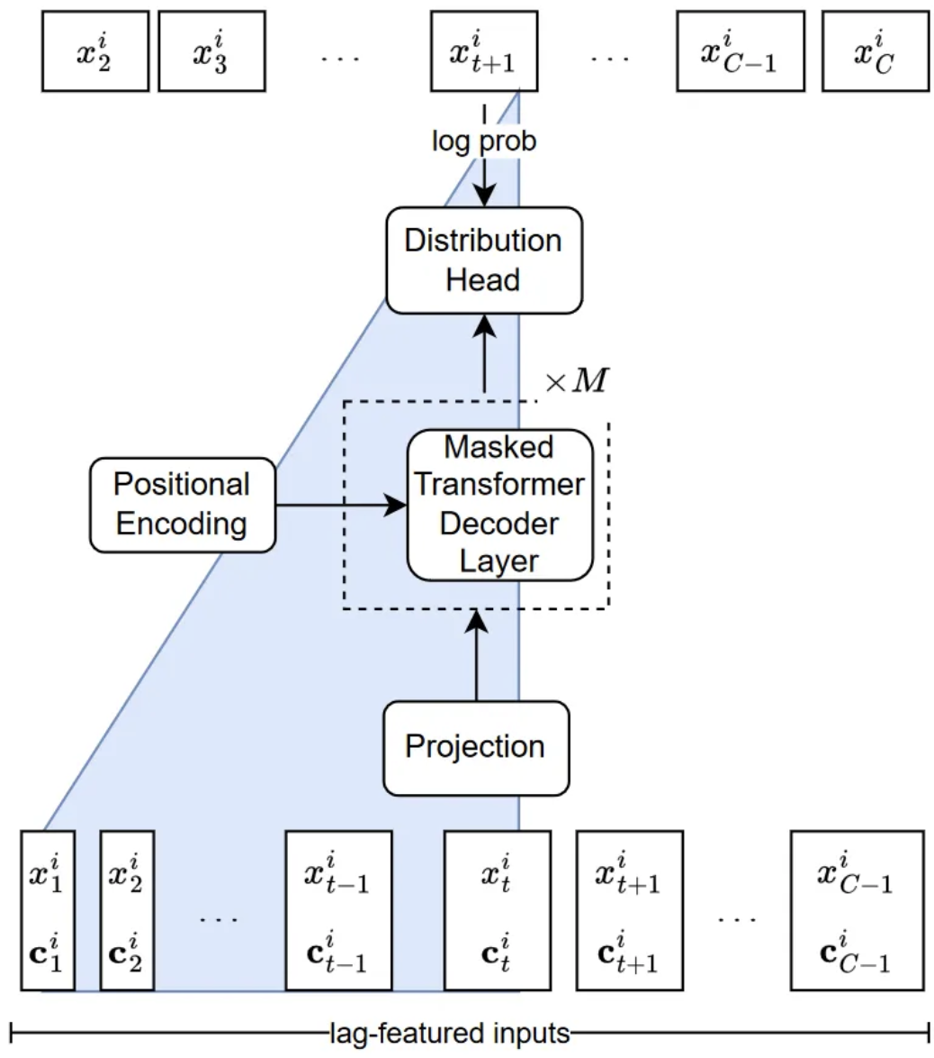
LagLlama
Univariate Forecasting based on tokenization strategy
Zero shot prompting
Static covariates + Lagged features
Probabilistic forecasting with uncertainity intervals

Slide 26
TimeGPT
Univariate Forecasting based on tokenization strategy
Zero shot prompting
Static covariates + Lagged features
Probabilistic forecasting with uncertainity intervals

Slide 27
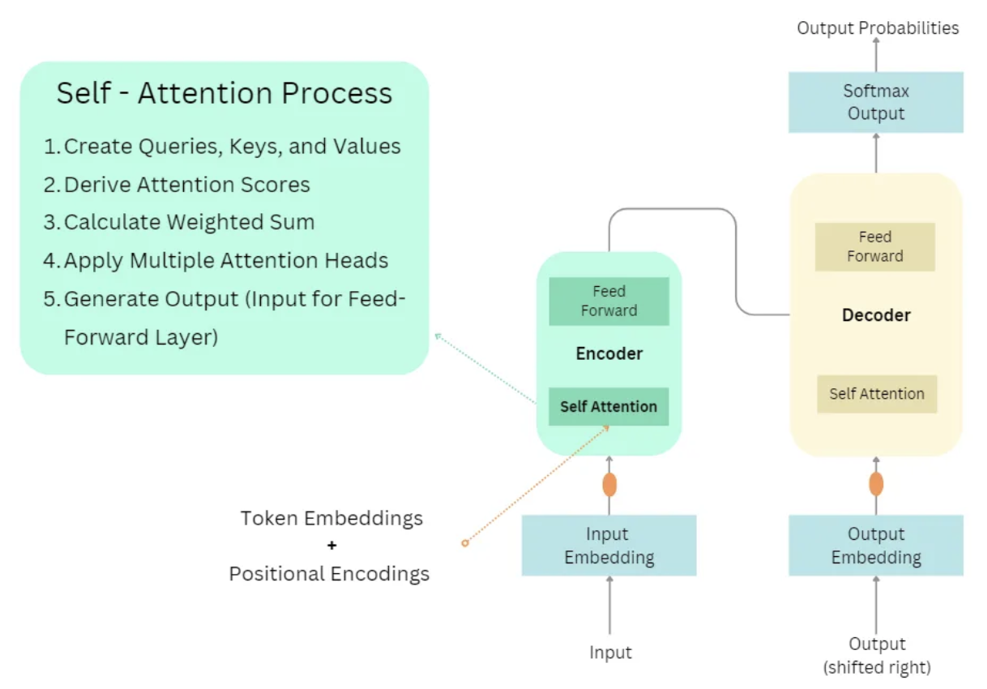
Transformers -Attention is all you need

Slide 28
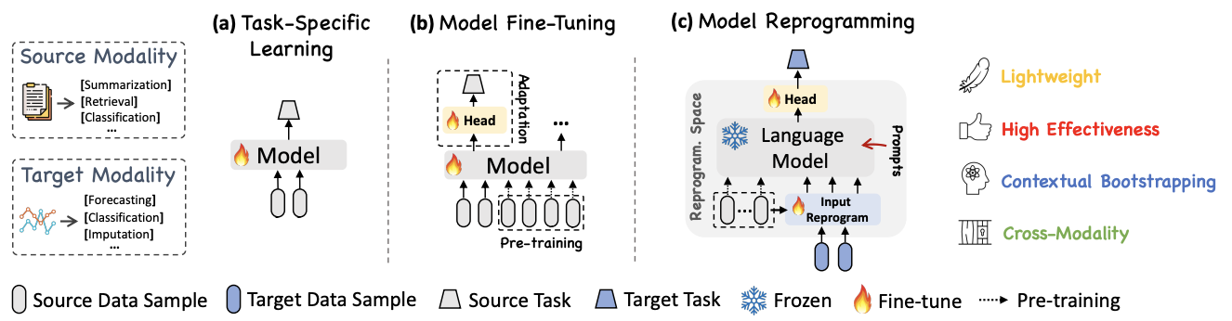
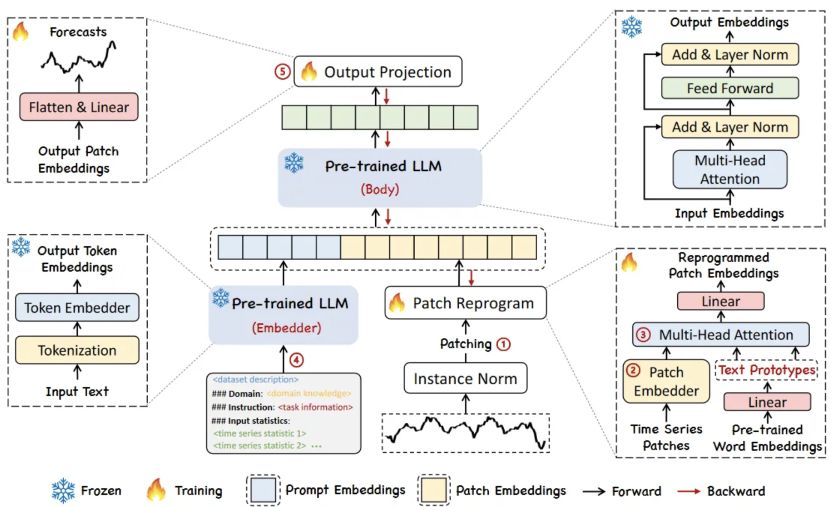
TimeLLM

Slide 29
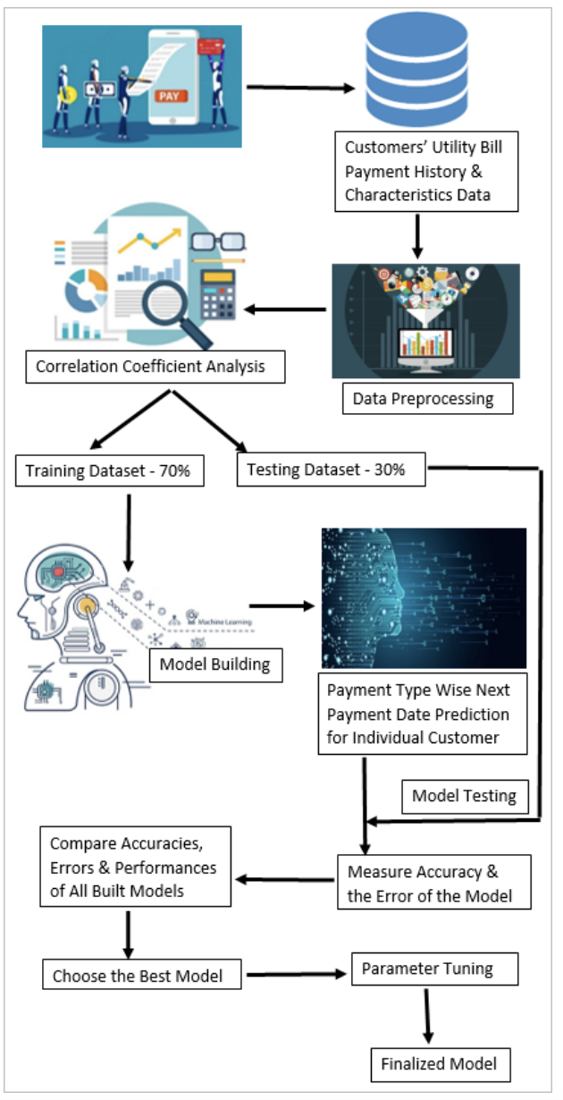
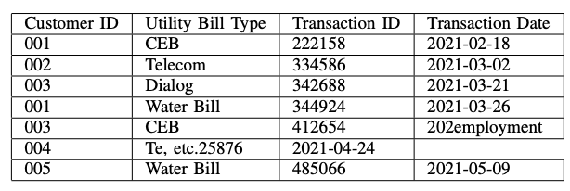
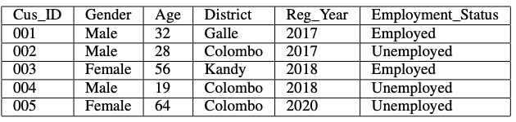
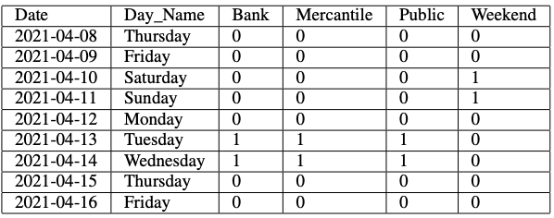
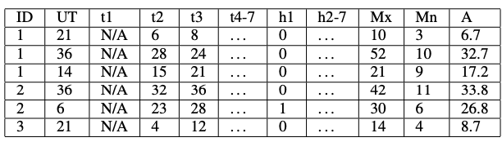
Feature based ML - XGBoost

Slide 30
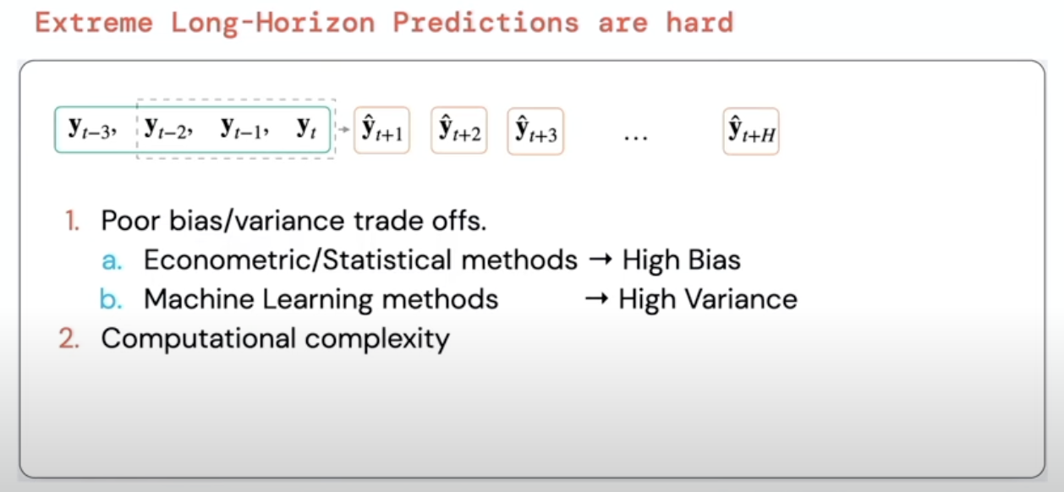
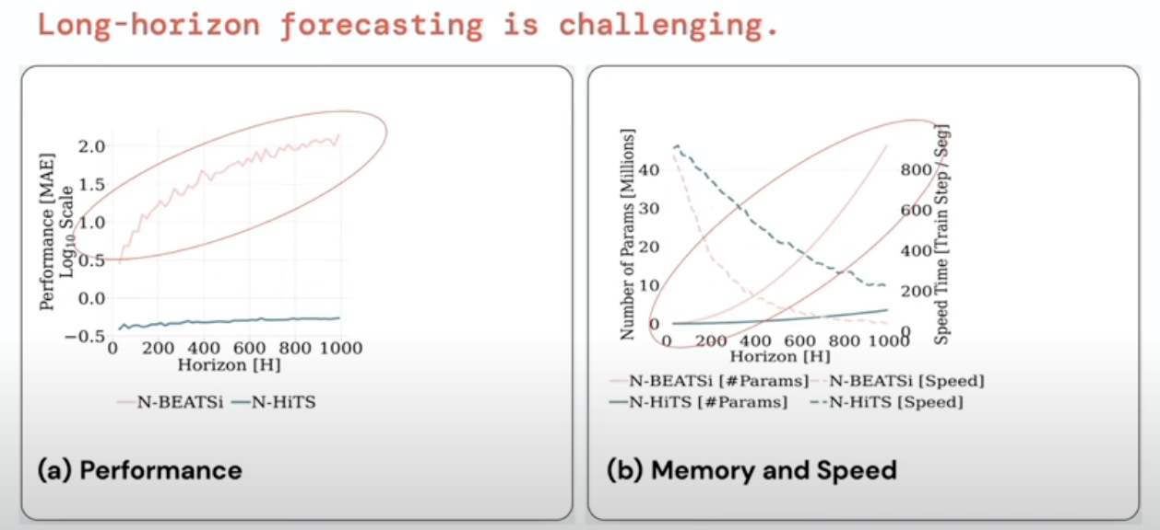
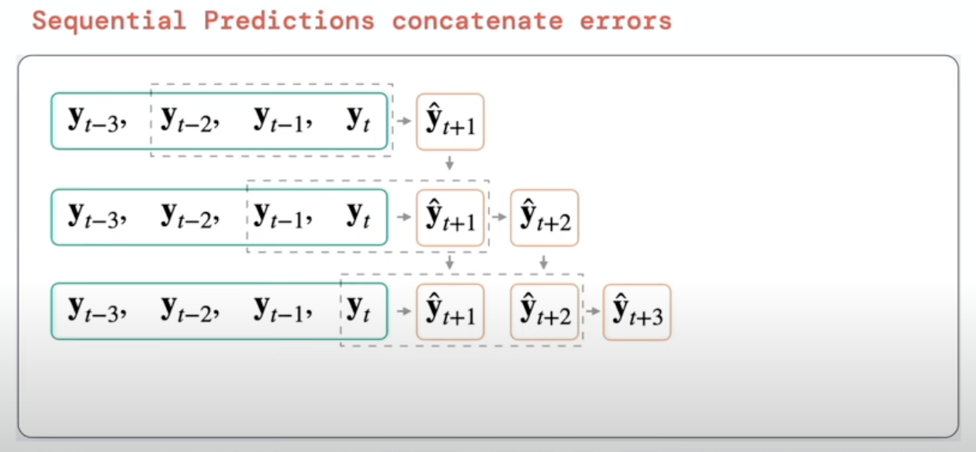
nHITS motivation

Slide 31
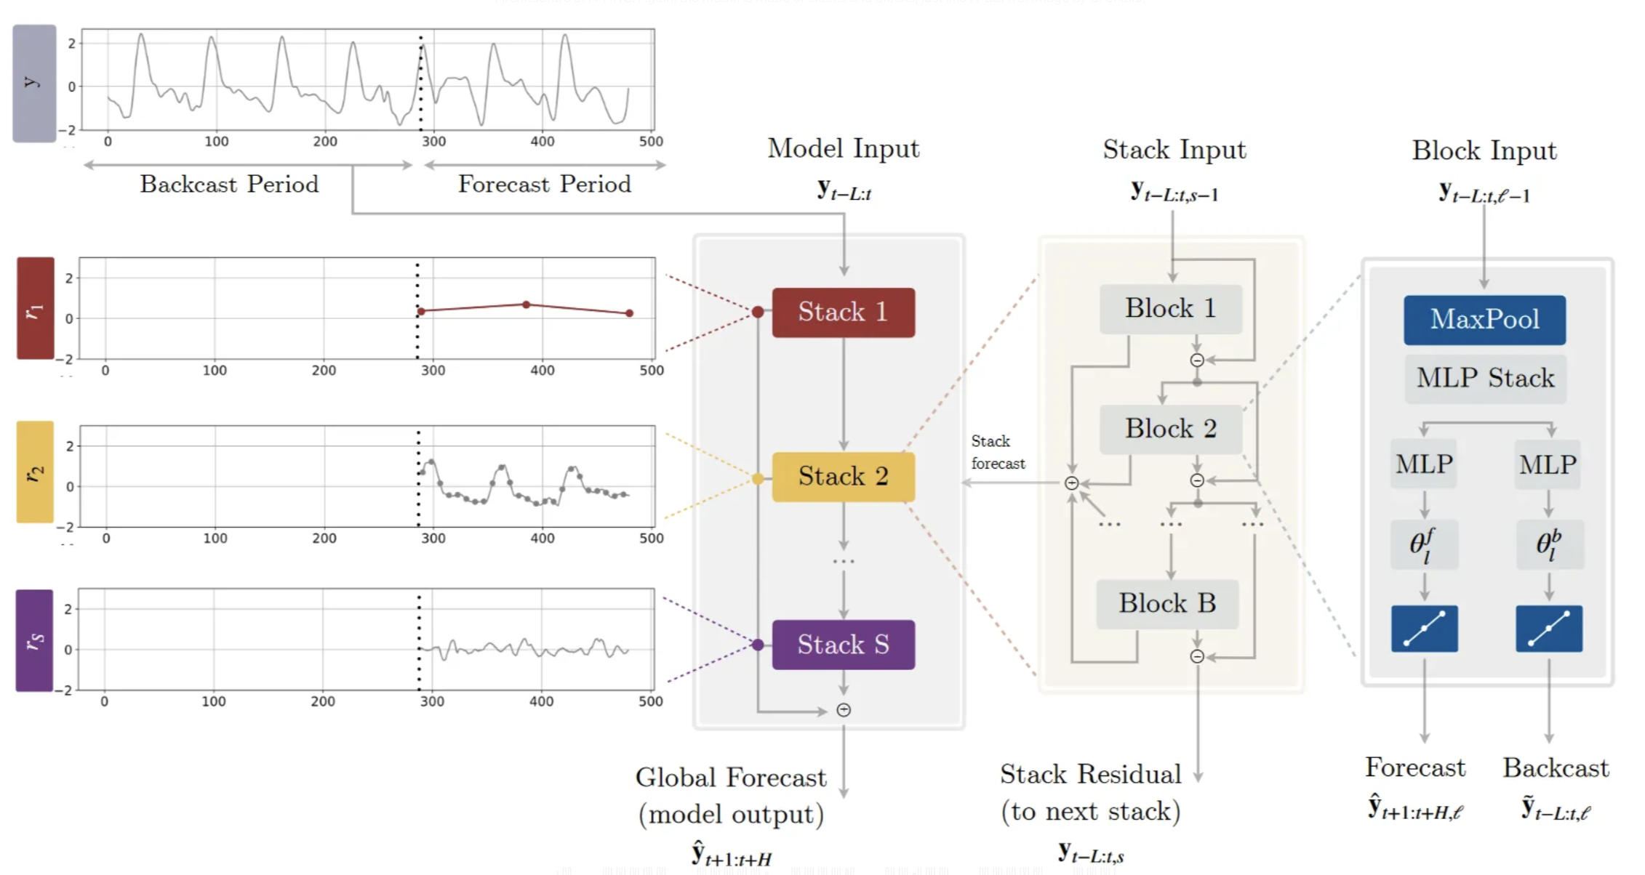
nHITS

Slide 32
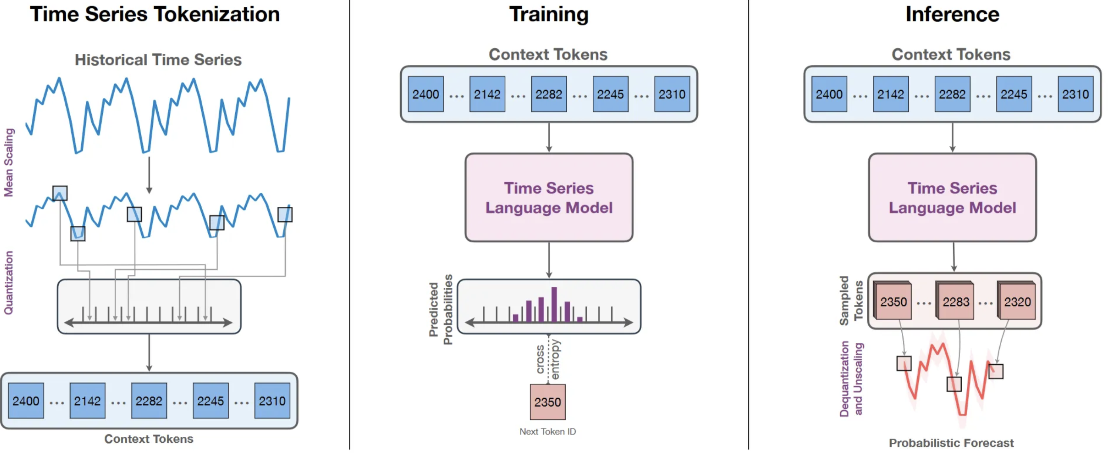
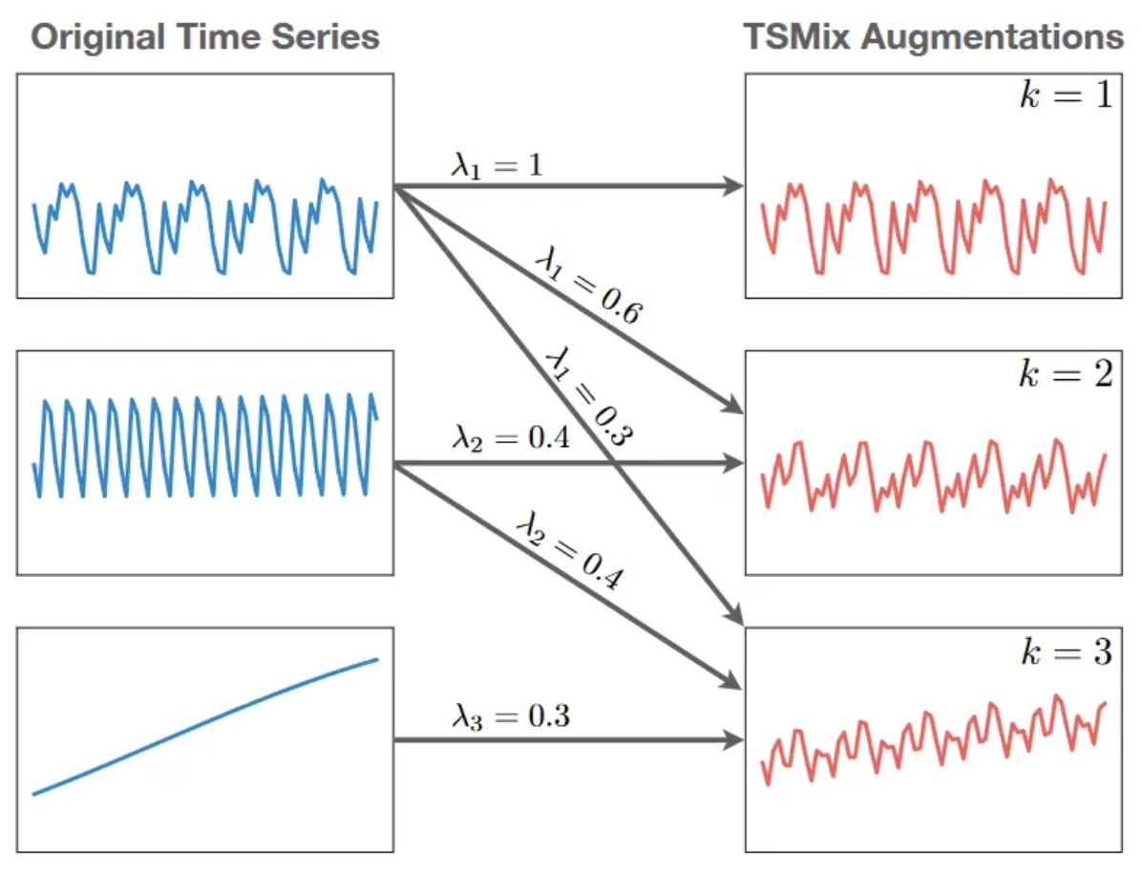
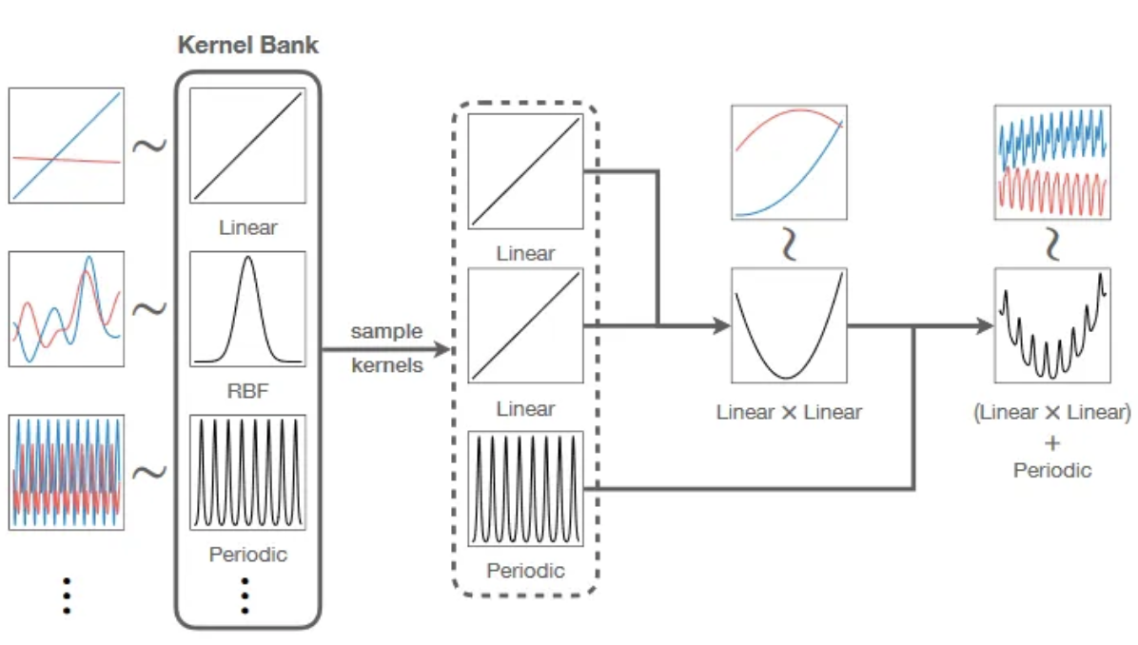
Chronos

Slide 33
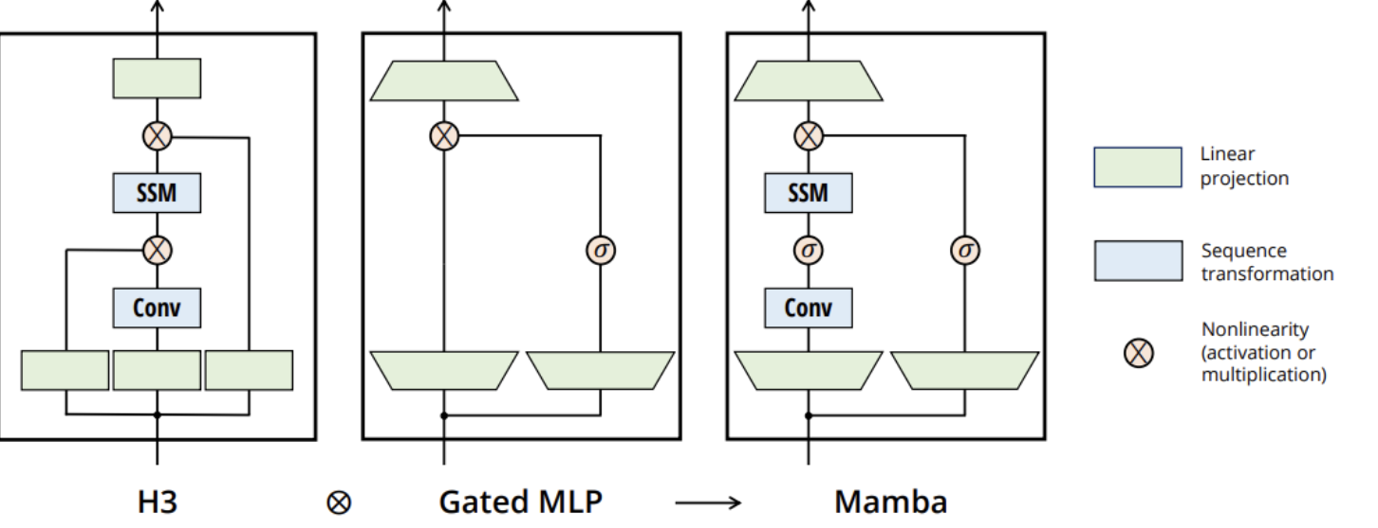
Mamba- S4 + CNN

